Slide 1


Prediction of TEC variations with Artificial Intelligence using Space Weather Data as input
Project ID: PCS25-19
Guide: Dr. Harsh Khatter (Associate Professor, CS) Scholars: Aryan Kaushik (2200290129006) (CS 6A)
Ananya Srivastava (2100290120028) (CS 6A)
Manas Rai (2100290120100) (CS 6B)

Slide 2
Problem Statement
The ionospheric electron density is sensitive to the space weather parameters and shows variation with respect to them
The information about these parameters are available before they actually influence the terrestrial ionosphere
These parameters affect the ionospheric TEC, which in turn shows abrupt variations and deviations
from the nominal characteristics
The performance of the GNSS system is also affected by the ionospheric variabilities
Prediction of the TEC provides a handle to take necessary actions to avoid or mitigate the resultant
impairments
Once trained, the AI based algorithm may predict the expected TEC variations which can be used by the concerned users
•
Refer SS612 at https://sih.gov.in/sih2022PS

Slide 3
Objectives
To prepare a web based interface to visualise the continuous trends in variations of TEC (total electron content) as detected by GNSS (global navigation satellite systems).
To prepare a dataset (from satellite data) comprising of various features affecting the TEC value in the ionosphere.
To train an effective machine learning/deep learning model on data to detect sudden
anomaly in TEC change during solar storms or heavy magnetic solar winds.
To have an effective alert generation module in case any threat is detected also integrating it with backend and the backing it with AI model.

Slide 4
Tech Stack
Artificial Intelligence & Machine Learning, Deep Learning
Python
Streamlit

Slide 5
Timeline of the Project
Phase 1:
Create a sample data set based on research papers and known variations
Create an initial model based on the data
Phase 3:
Train the model on real data from Satellites
Calculate and verify the accuracy of predictions with real TEC variations
Phase 2:
Develop website and display the resultant data
Host the website
Create anomaly detection system
Phase 4:
Display data in easy to understand
charts and heat maps on website
Create alert module
Write documentations on findings

Slide 6
Status of Proficiency
Research papers read and concept about TEC variations have been understood to a certain level.
Preparation of forming a dataset of the problem is in progress and search for the resources is currently being carried out.
ISRO Mentors were contacted to get relevant data and resources
Reached out to paper authors for guidance
Meeting was conducted with project guide to understand project outcomes

Slide 7
Current Implementations Present
Currently no easy-to-use public domain website exists
Research papers and thesis are published at prestigious universities and organizations like:
IEEE
Harvard University
University of Michigan
KL University
Etc...

Slide 8
Methodology
Data Collection and Preprocessing
Feature Selection and Engineering
Model Development
Model Interpretability and Evaluation
Validation Across Different Regions
Application in Radio-Based Systems
Optimization and Fine-Tuning
Documentation and Reporting

Slide 9
Dataset Preparation
Ionolab numerical satellite data (www.ionolab.org)
Geomagnetic values (WDC.kugi.kyotou.ac.jp)
Sunspot numbers
F10.7 from space observatory(Bangalore)
Solar Index and flares (https://www.nasa.gov/goddard/)

Slide 10
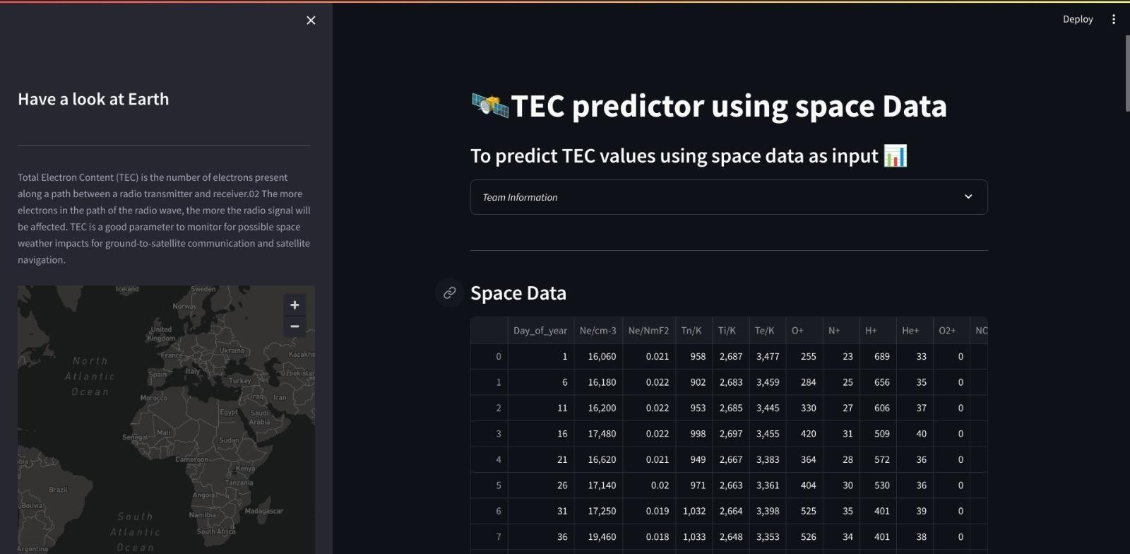
Screenshots

Slide 11
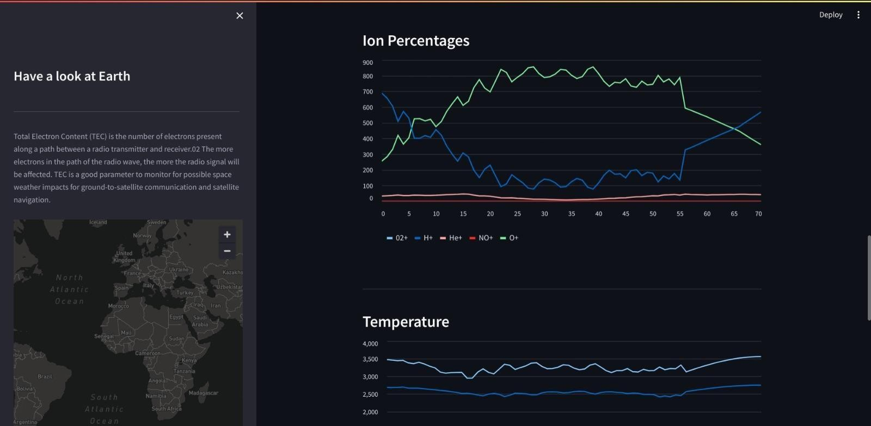
Screenshots

Slide 12
References and Resources
https://omniweb.gsfc.nasa.gov/
https://www.swpc.noaa.gov/
https://wdc.kugi.kyoto-u.ac.jp/wdc/Sec3.html
https://igs.org/data/
https://deepblue.lib.umich.edu/bitstream/handle/2027.42/163558/swe21083_am.pdf?sequ
ence=1
https://ieeexplore.ieee.org/document/10005062
https://www.mdpi.com/2073-4433/13/11/1939

Slide 13
Thank You

